Slide 1
Communication architecture of ROS
RISE Dingchao Liao
2018.10.31

Slide 2
Outline
1. Engineering structure of a ROS project.
2. Introduction of nodes.
3. How do nodes conmuinicate?

Slide 3
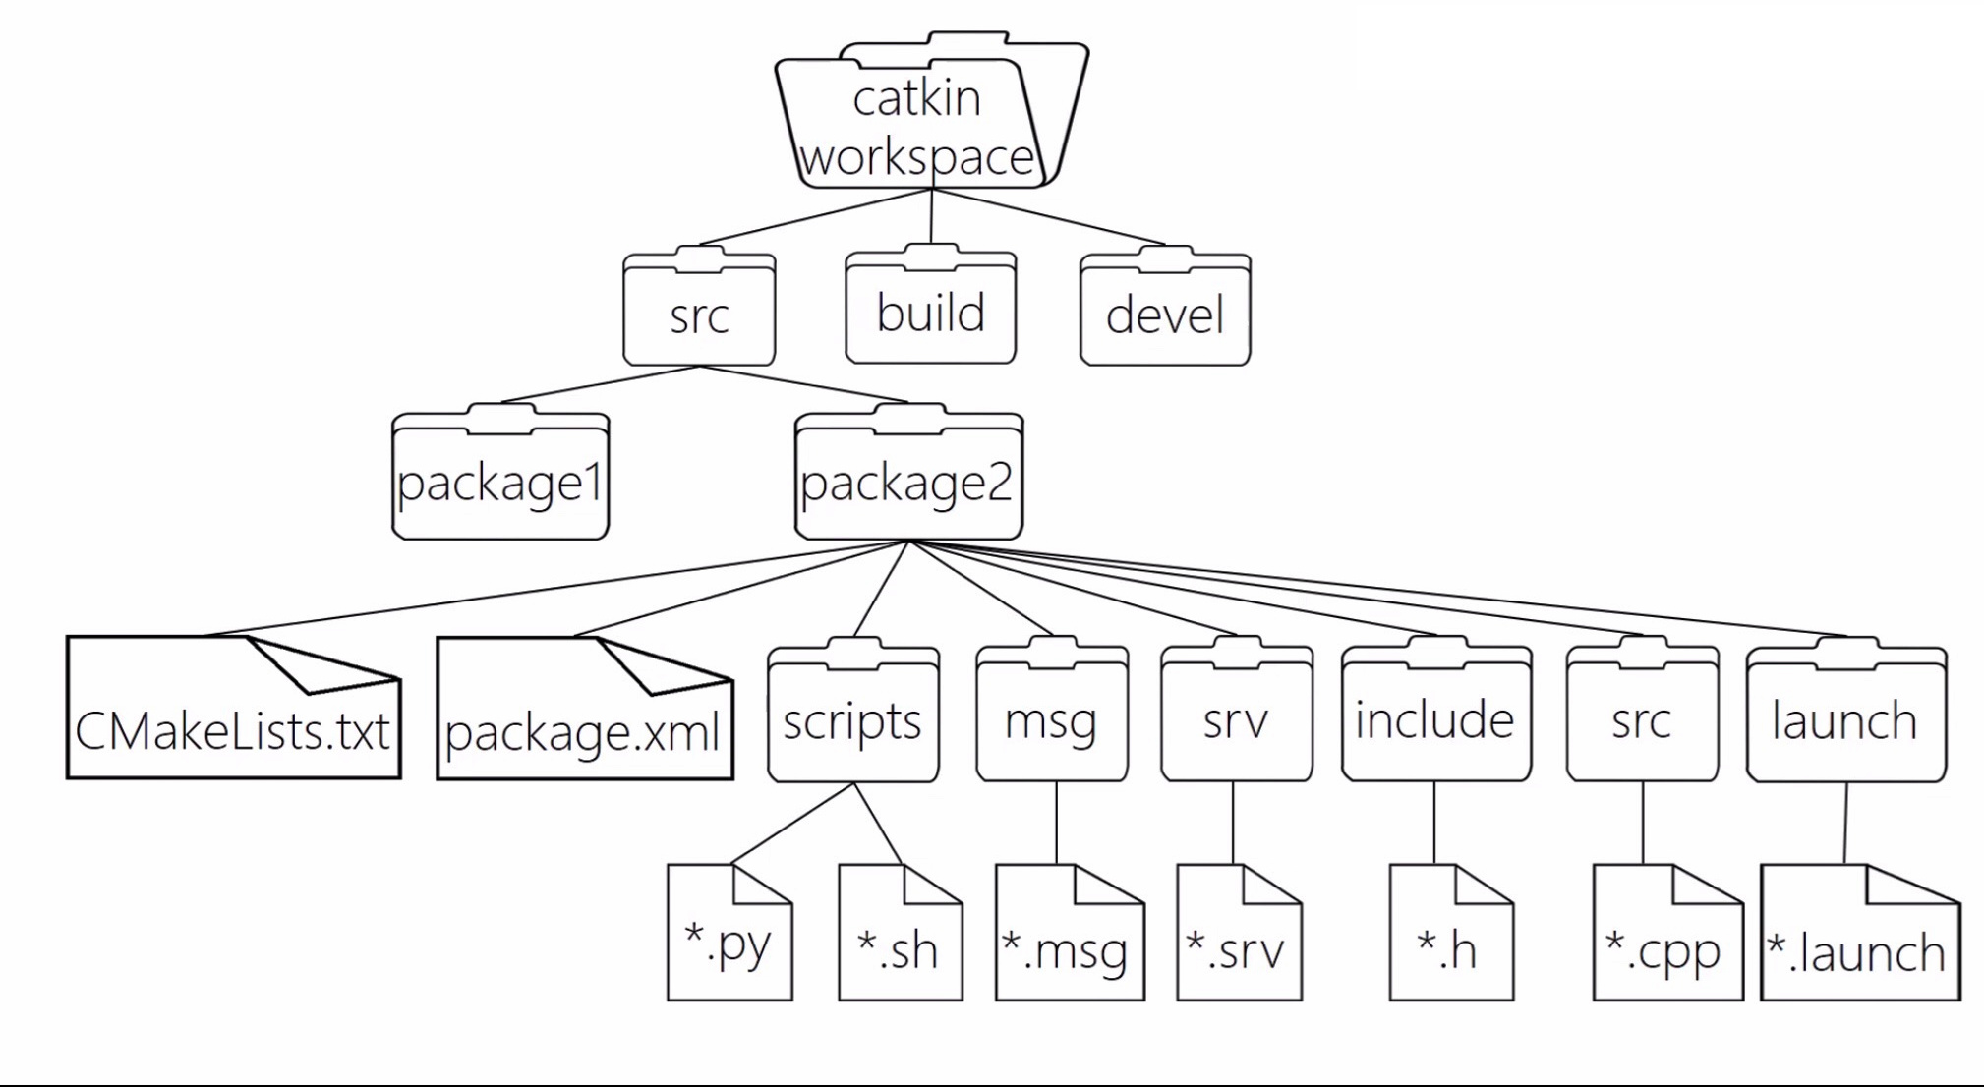
Engineering structure

Slide 4
Node in ROS & Process in OS
The nodes in ROS are similar to the processes in OS.
Each node is a specific program instance.
Master, the manager of nodes.
master
login
control
login
control
node1
node2
communicate

Slide 5
How do nodes communicate?
1.Topic
The most used communication method in ROS.
A name for a string of massage.
An asynchronous way of communication.
node1
/topic
node2
publish
subscribe

Slide 6
An example of ropic
node_
viewer
/camera_rgb
node_
camera
node_
processor
/camera_depth
node_
point clouds
A node can publish multiple topics.
But a topic can only be published by one node.
A topic can be subscribed by multiple nodes.
A node can also subscribe to multiple nodes.

Slide 7
How to implement a topic?
*.msg file
Its address is pcgname/msg/*.msg
This file is a structure containing various types of data.
The specific published topic is an object or instance of the class
eg.
For a simple example, if we let a node publish the location information of the robot, publish it at any time to form a specific topic, and another node subscribes to this information.

Slide 8
Publisher.cpp
#include <ros/ros.h> #include <topic_demo/gps.h> int main(int argc, char **argv) { ros::init(argc, argv, "talker"); ros::NodeHandle nh; topic_demo::gps msg; msg.x = 1.0; msg.y = 1.0; msg.state = "working"; ros::Publisher pub = nh.advertise<topic_demo::gps>("gps_info", 1); ros::Rate loop_rate(1.0); while (ros::ok()) {
msg.x = 1.03 * msg.x ; msg.y = 1.01 * msg.y; ROS_INFO("Talker: GPS: x = %f, y = %f ", msg.x ,msg.y); pub.publish(msg); loop_rate.sleep(); } return 0; }
gps.msg
string state
float32 x
foat32 y

Slide 9
How do nodes communicate?
2. Service
request
node 1
/service
node 2
reply
Client
Server
1. This is a synchronous way of communication.
2. Similar to the C/S communication model in computer networks.
3. This communication method is suitable for communication between nodes that are not used frequently.
4. This way is implemented by *. srv file

Slide 10
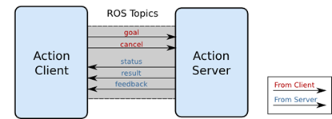
How do nodes communicate?
3. Action
1. Action is actually an improvement of the service communication method.
2. Defining an action requires three parts: goal, result, feedback.
3. This method is suitable for long-term controlled services.
4. This way is implemented by *.action file.

